Slide 1
Enterprise Application Architecture Portfolio Management (EAAPM) & Visual Studio Subscriptions (MSDN)

Slide 2
EAA Portfolio Management
Who Are We?
As part of Platform and Engineering Practices, the Enterprise Application Architecture Portfolio Management (EAAPM) team is focusing on standardizing the Software Development Tools used within UHG/OPTUM. Our mission is to effectively manage a portfolio of application development technology standards and tools to reduce variation and increase standardization.
Software Development Tools Portfolio Management
The primary goals of this program are (1) to evaluate and standardize existing development tools (2) to provide a knowledge base of the tools in our environment, thus significantly improving adoption and use of standard tools and (3) to reduce future variation by providing a centralized request process

Slide 3
EAAPM Vision
Provide services on day-to-day operational work as well as strategic work to enable Software development teams across all UHG/OPTUM business segments {Including External Entitles } for standardize and optimize UHG/OPTUM development tool kit and establish processes to manage variation and drive cost avoidance savings.
Background
The Platform and Engineering Practices and UHG/OPTUM IT Procurement teams jointly launched the Enterprise Application Architecture Portfolio Management (EAA PM).
To help standardize and optimize UHG/OPTUM development tool kit and establish processes to manage variation
Primary goals:
Evaluate and standardize existing development tools
Provide a knowledge base of the tools in our environment, thus significantly improving adoption and use of standard tools
Reduce future variation by providing a centralized request process

Slide 4
EAAPM Activities- Appstore Apps
Evaluate and standardize existing development tools and Apps.
Provide a knowledge base of the tools in our environment, improving adoption and use of standard tools
Reduce future variation by providing a centralized request process
Product Ownership activities
Restricted Application Approvals for Microsoft Tools
Microsoft Application Certifications.
Assist teams with questions on Microsoft tools .
Retiring Old Version & Apps which are outdated.
Added New Apps & New Version which are in-demand.
Re-packaging of VS –Apps & include Inbuilt Product key within Auto-Installations

Slide 5
Visual Studio Subscriptions
Administration of 4000+ Visual Studio Subscriptions (a.k.a MSDN).
Collaboration with compliance teams for optimization and process improvement.
Complete the merger activities of SLP MSDN agreements into single enterprise agreement- EAP
Automation of various critical activities
MSDN Request Cycle - Requesting, validating and Granting license
Cost Avoidance – Periodically and just-in-time reclaiming MSDN subscription
Subscription levels being managed
Visual Studio Enterprise w/MSDN
Visual Studio Pro w/MSDN
Visual Studio Test Pro w/MSDN
Providing:
Cost Savings
Improved Efficiency
Maximized ROI

Slide 6
Current Subscriptions Status
Total Vs. Assigned Subscriptions

Slide 7
MSDN Subscription
Monthly Allocation Trend

Slide 8
MSDN Subscription
Monthly Termination Trend

Slide 9
Total Subscription Reconciliation- Cost Avoidance

Slide 10
License Compliance and Automation Solution
Optimize Visual Studio Subscription (so called earlier - MSDN license) across the organization.
Specific information is gathered from various enterprise systems to support decisions (Allocate, Retract, and Upgrade etc.).
Appstore, Altiris, Snow, OASIS, Active Directory and PeopleSoft are participating into the automation of MSDN and License/Software Compliance analysis.
Analysis available today:
Overutilization.
Underutilization.
Unauthorized MSDN users.
Server Access users without Proper licenses.
Reclaiming MSDN based on users PeopleSoft/ Snow Status.

Slide 11


.NET FRAMEWORK REMEDIATION
Note: We have involved to identifying activates & process for various old version of .NET Framework which are proposed to un-install from the Optum / UHG App-Servers.

Slide 12





Un-installation of older .NET Framework versions
Impact Analysis of installation / uninstallations of .NET Framework version {4.62 and prior versions} should be done by performing the actions on the lowest environment and thoroughly testing the same
Perform a thorough Impact Analysis of installation or uninstallation of.NET Framework version by installing / uninstalling on the lower environments before performing the action on upper environments
Installation of latest .NET Framework version 4.8

Slide 13
Proposed Activities for Remediation of .NET Framework versions- on Servers
Identify the .NET Framework versions from ITSM CI Central -> PLM Tab that to be remediated for your respective application
Perform a thorough Impact Analysis of installation or uninstallation of.NET Framework version by installing / uninstalling on the lower environments before performing the action on upper environments
Ensure that the latest version of .NET Framework is installed on the server and application dependencies pointed to it before uninstalling the older framework
Upon the lower environment being signed-off as working, the installation/uninstallation of .NET framework versions should be done in production

Slide 14
Appstore – Restricted Application’s Request-Approvals
RA- Report- Jan 2021 to November 1th Grand Total - 2482

Slide 15
2021 achievements & 2022 roadmap for MSDN & EAAPM
2021- Achievements-MSDN
Completed the merger activities of SLP agreements into single enterprise agreement –EAP.
Reclaimed the unused 500 + Visual Studio Subscriptions.
Completed true-up of MSDN subscriptions with out procuring additional licenses, which has saved several million dollars.
Implemented license transfer module in MSDN internal portal.
Zero escalations and 100% customer fulfillment.
2022-Road Map-MSDN
Complete true-up activity without any new license procurement.
Organize sessions for the users across the org to share MSDN benefits.
Automate the VS Allocation with RA Automation. Teams-Chatbot App –Web API development ( Proposed for Bright Idea)***
VS 2022 – Bring New App Version in Appstore
EAP Agreement Renewal activities.

Slide 16
2021 achievements EAAPM

Slide 17
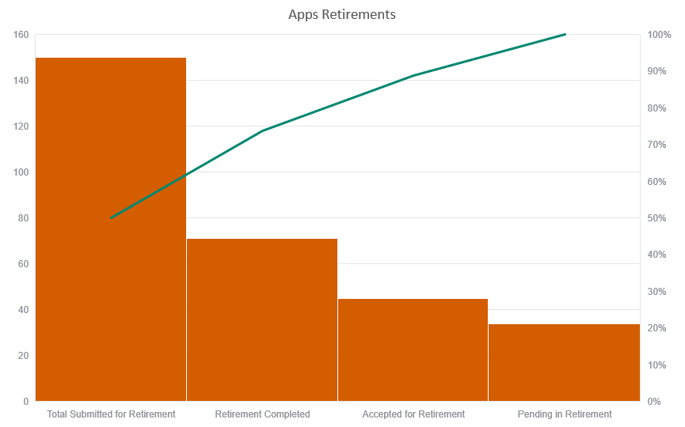
2021 achievements EAAPM –Apps Cleanup

Slide 18
2021 achievements and 2022 roadmap for MSDN & EAAPM
2021- Achievements-EAAPM
Completed certifications of about 10+ new versions of the products.
Retired all the older version which were out of support.
Supported user quires of about 50+ on average monthly.
Zero escalations and 100% customer satisfaction.
2022-Road Map-EAAPM
RA Automation- Approval process is in pipeline for automated. Maintain the stability with customers fulfilments .
Organize sessions for the users across the org to share information.
Docker Paid Subscriptions –to be bring new Docker paid subs for users - In process Negations now.

Slide 19
MSDN Automation Process
SN
SNOW Report
SNOW
Unauthorized Data
Compliance Team
PeopleSoft
Over License Utilization
Developer
ETL
Automation process
Data Load
Poor License Utilization
Mail
Optum Azure Site
Altiris
Licenses to be reclaimed
MSDN Team
MVLS
MVLS Report
Update License Pool
Reconcilition

Slide 20
THANK YOU ☺
Ranjeet Bhargava
bhargava_ranjeet@optum.com

